Slide 1
CONCRETE MANUFACTURING INDUSTRY ANALYSIS
MANVI BAJPAI – PGA 30

Slide 2
Steps to find the best concrete………...
UNDERSTANDING THE CEMENT/CONCRETE INDUSTRY
KEY OBJECTIVES OF THE CAPSTONE PROJECTS
EXPLORATORY DATA ANALYSIS (EDA)
VISUALISATION ( UNIVARIATE & BI-VARIATE )
CORRELATION ANALYSIS – HEAT MAP
SCALING AND MODELLING OF THE DATASET
HYPERMETER TUNING
CONCLUSIONS

Slide 3
The purpose of this study is to identify the best cement/concrete product available on the market, evaluate its strength using various machine learning modelling techniques.
Project Description
Step I: Examining different machine learning modelling techniques for finding the high performing and effective concrete.
Step II: Understanding how various ingredients used for the formation of concrete contributes to it's quality and high performance.
Step III: Finding the top two models that showcases at most accuracy and precision in concrete qualities and it's ingredients.
Project Findings
Dataset: https://www.kaggle.com/datasets/vinayakshanawad/cement-manufacturing-concrete-dataset
Data Source
i) The actual concrete compressive strength (MPa) for a given mixture under a specific age (days) was determined from laboratory. Data is in raw form (not scaled).
ii) The data has 8 quantitative input variables, and 1 quantitative output variable, and 1030 instances (observations).
Data Set
Polynomial Featurization, Linear Regression, Ridge & Lasso Regressor, KNN Regressor, SVM Regressor, Decision Tree, Random Forest, Bagging, AdaBoost & XG Boost
Modelling Methods

Slide 4
EXPLORATORY DATA ANALYSIS (EDA)…..
No. of Independent Variables : 8 { Cement, Slag, Water, Coarseagg, Fineagg, Ash, Superplastic & Age }
No. of Dependent Variables: 1 { Strength }
Rows: 1030 & Columns: 9 { All records are numeric }
Age – Integer Value and the rest of the attributes except age have Floating values.
Outliers: Found in 5 independent variables { Slag, Water, Superplastic, Fineagg and Age }. Will replace those outliers with median for respective attributes.
Missing Values : 0, hence no missing value treatment is required.
None of the independent variables have a strong relationship among themselves. So, there is no need to drop any of the features or to create a composite feature.

Slide 5
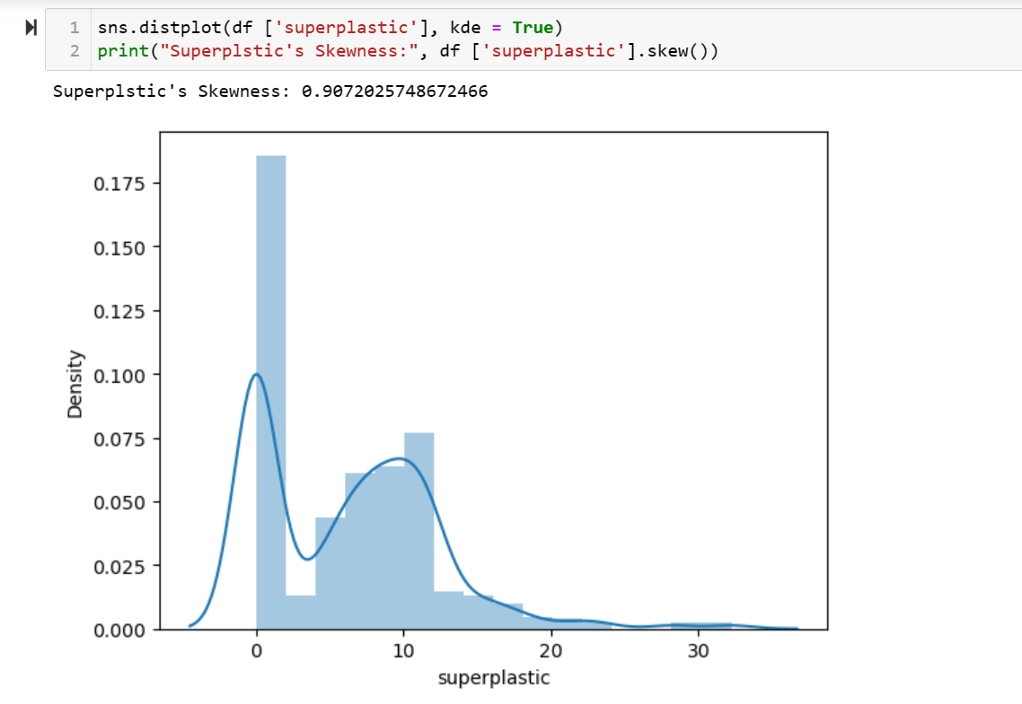
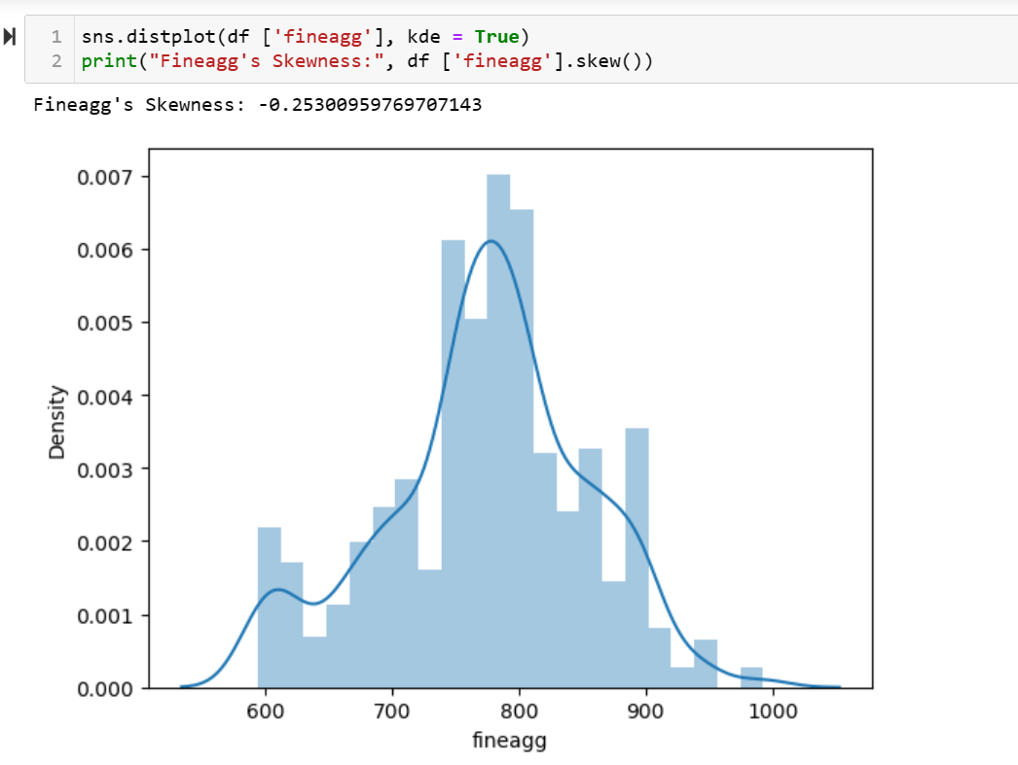
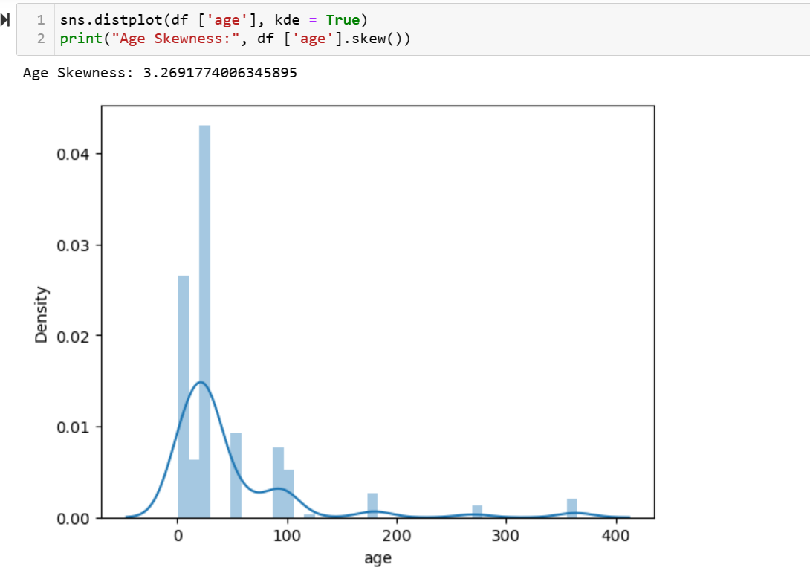
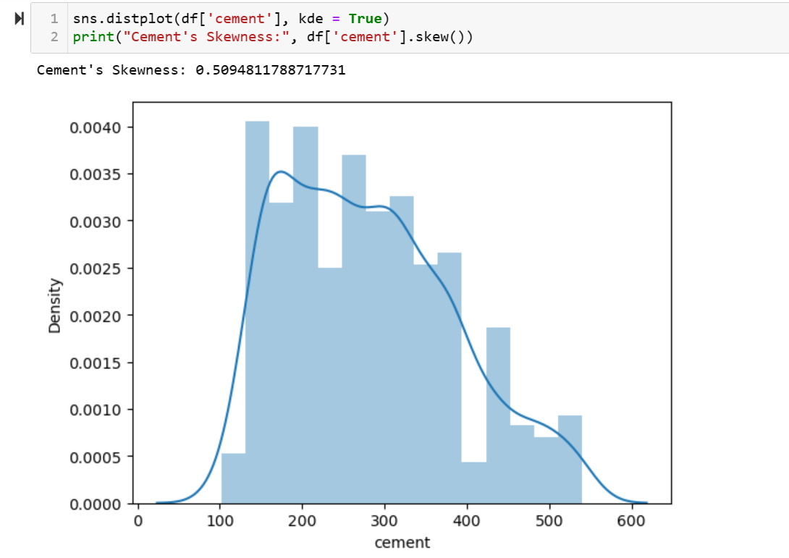
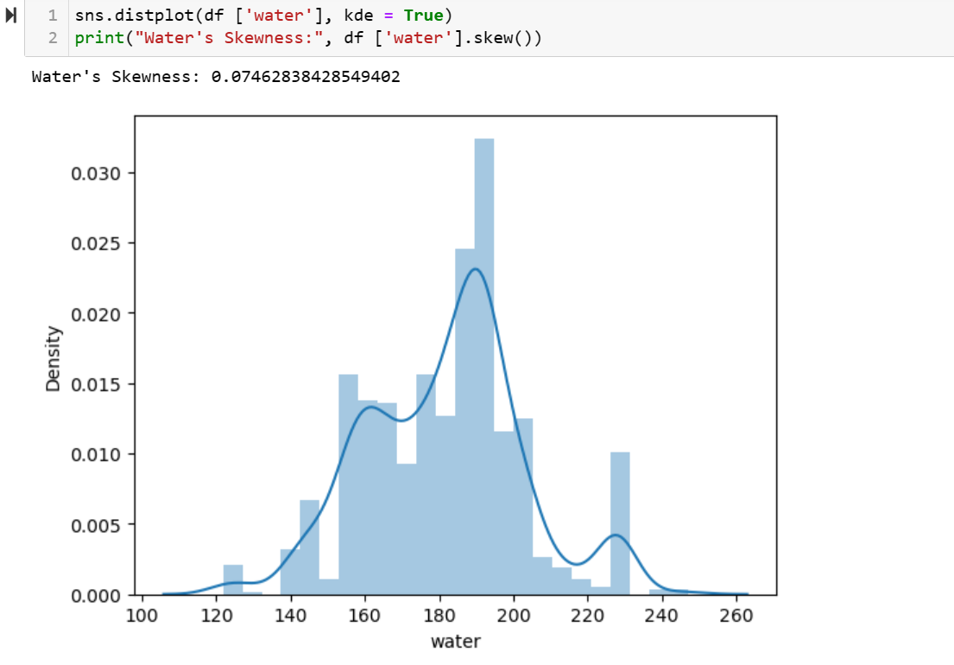
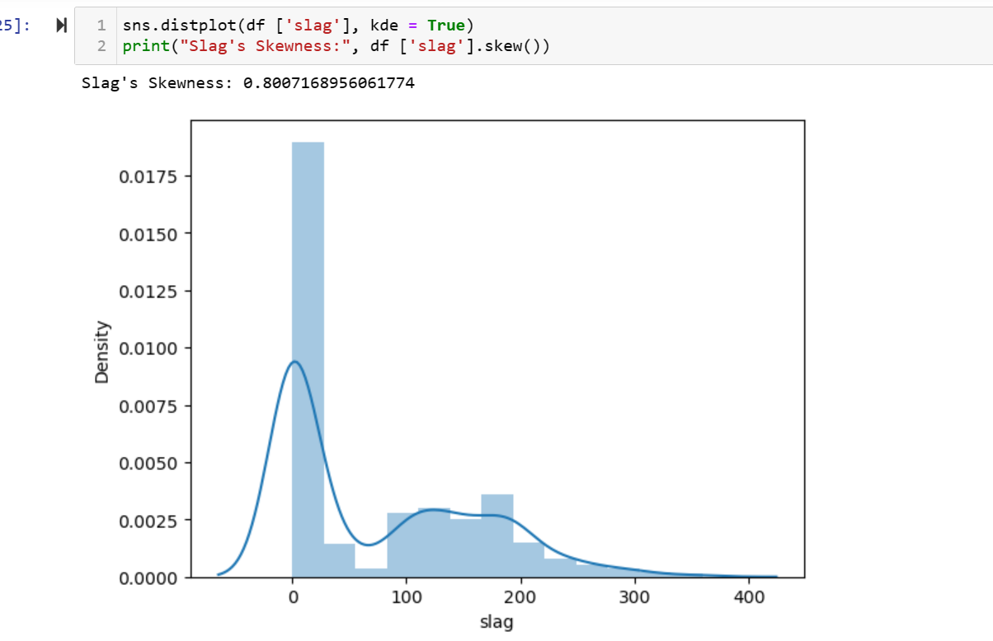
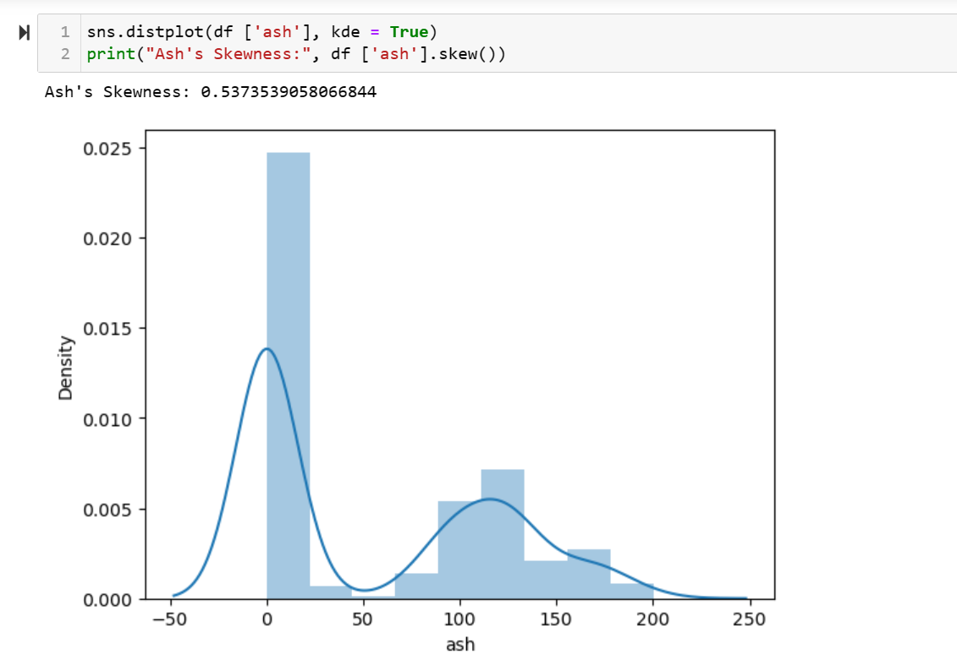
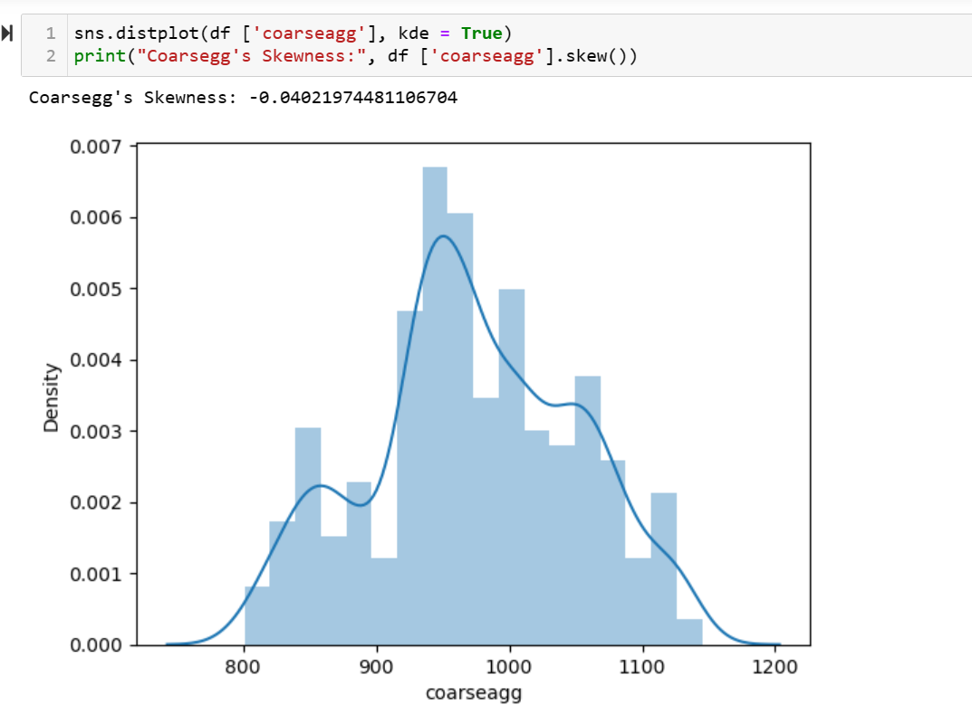
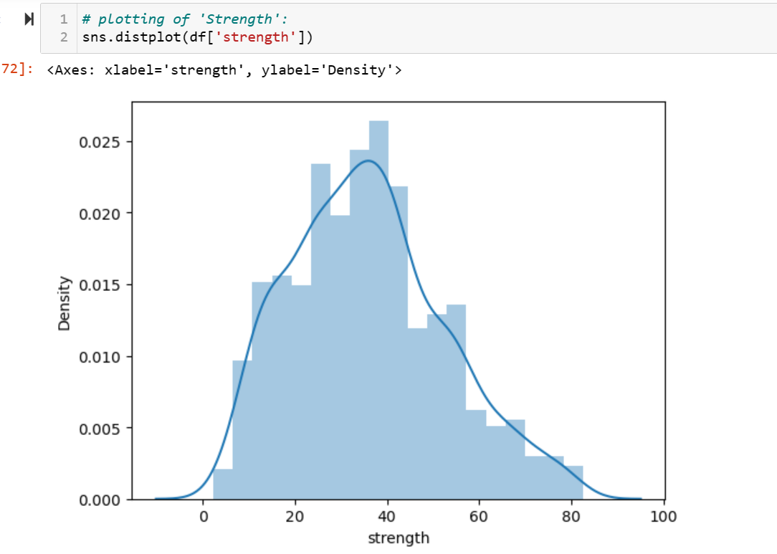
Visualisation of Univariate Analysis

Slide 6
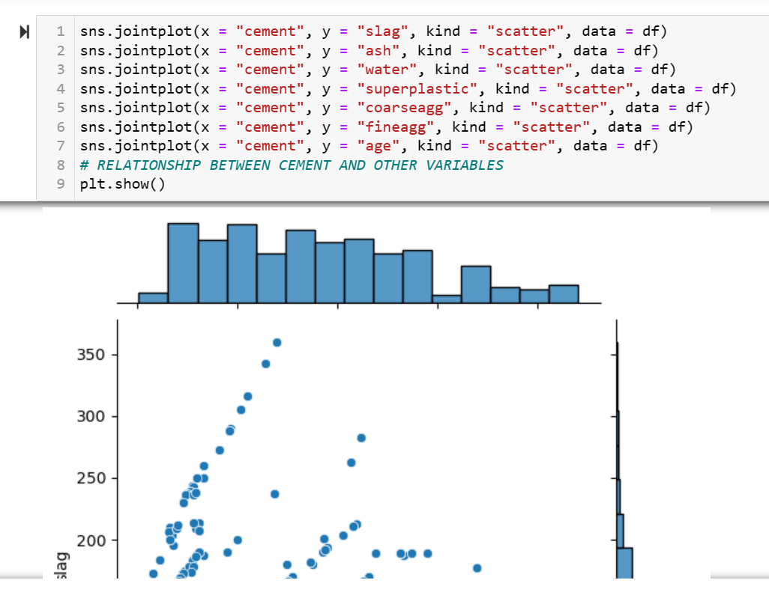
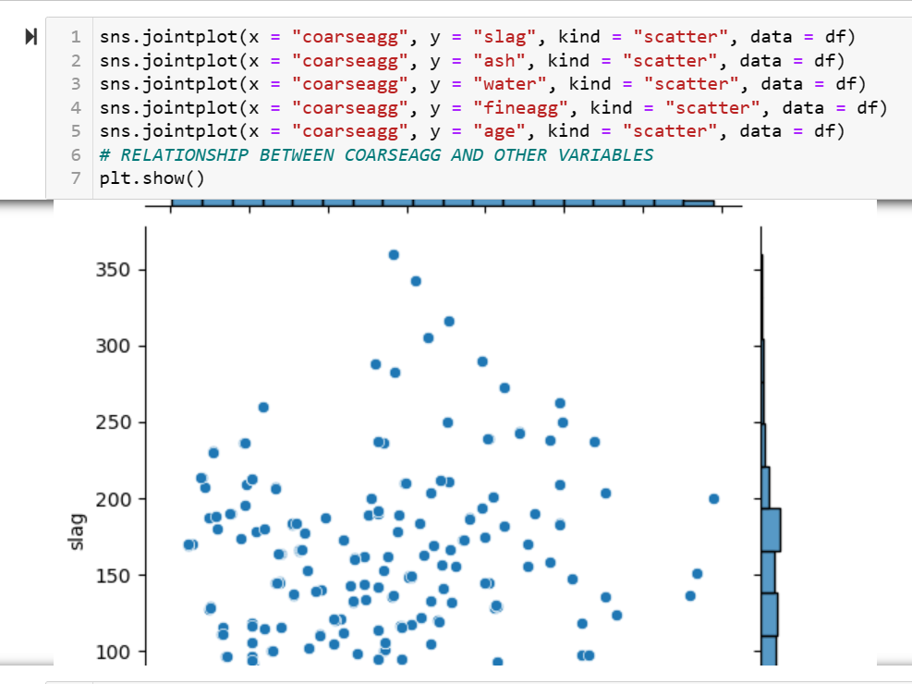
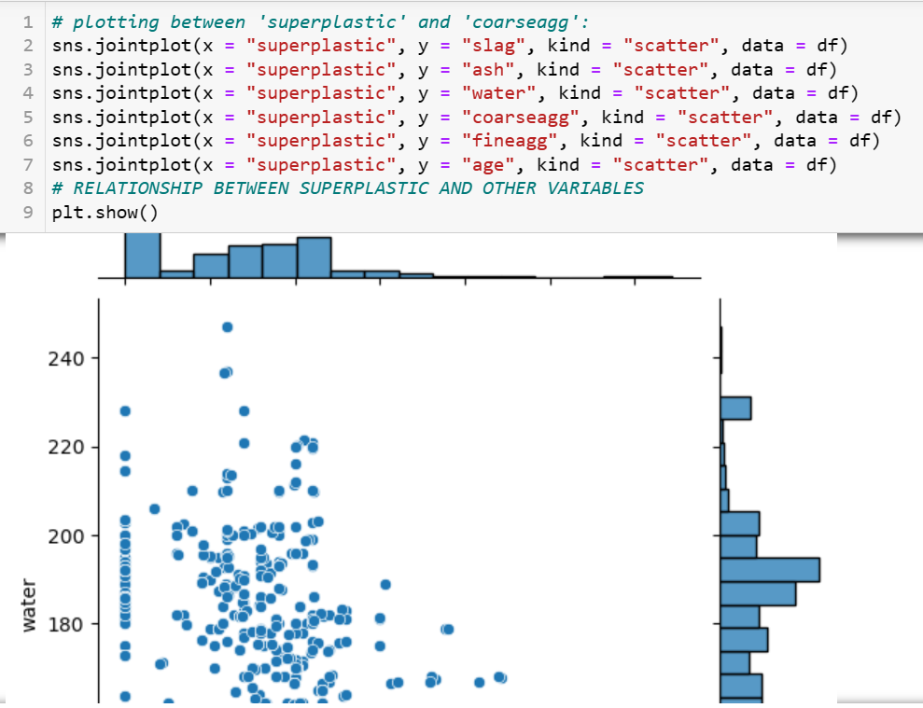
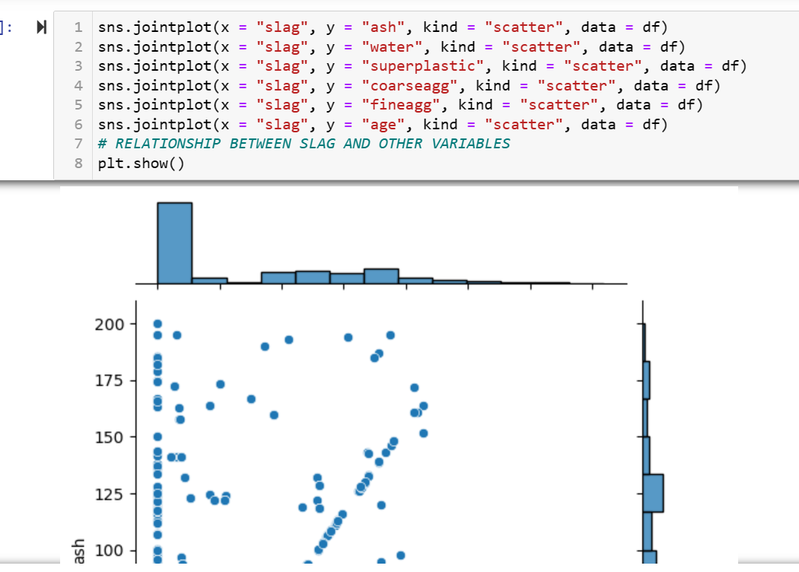
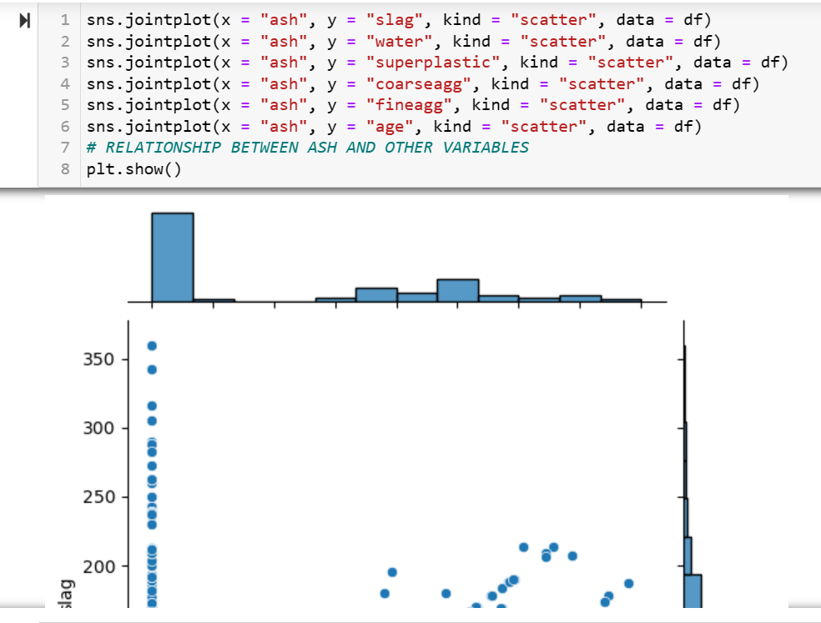
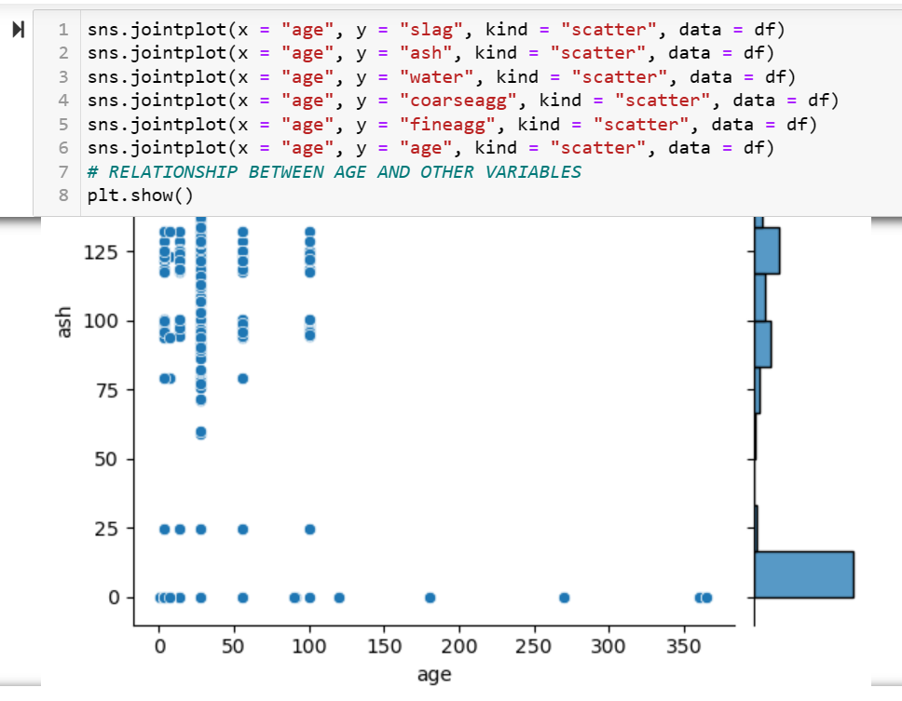
Visualisation Bivariate Analysis

Slide 7
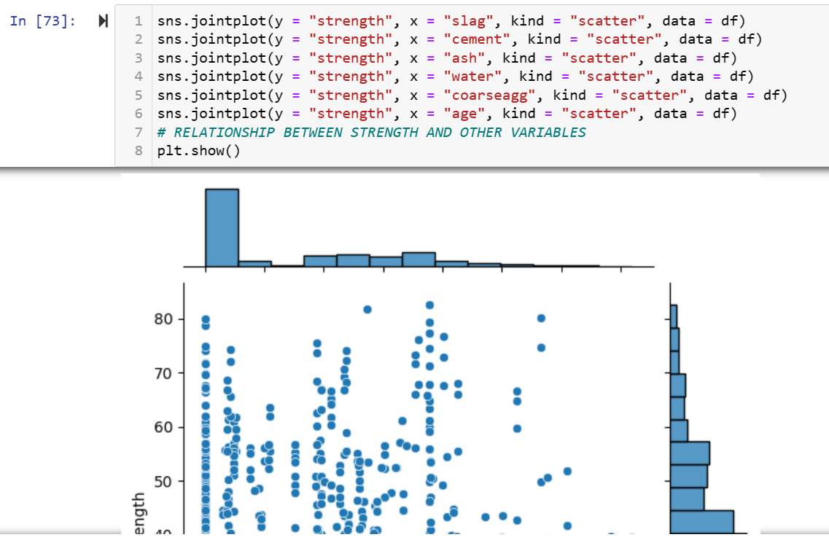
OBSERVATIONS:
Independent attributes: These attributes does not have any significant relation with each others.
Fineagg vs other independent attributes: It has negative linear relationship with water. It does not have any significant relation with any other attributes.
There is no particular trend between the dependent and independent variables except:
Cement & Strength: It somehow seems that the two are linearly related. The relationship is positive but what we can see is that, for a given value of cement we have a multiple values of strength (which one should we pick we don't know). Hence, cement though it has positive relationship with the strength, it is not a very good predictor. It is a weak predictor.
Hence, we can see that none of the independent attributes are a good predictors of the strength attribute.
Visualisation Bivariate Analysis

Slide 8
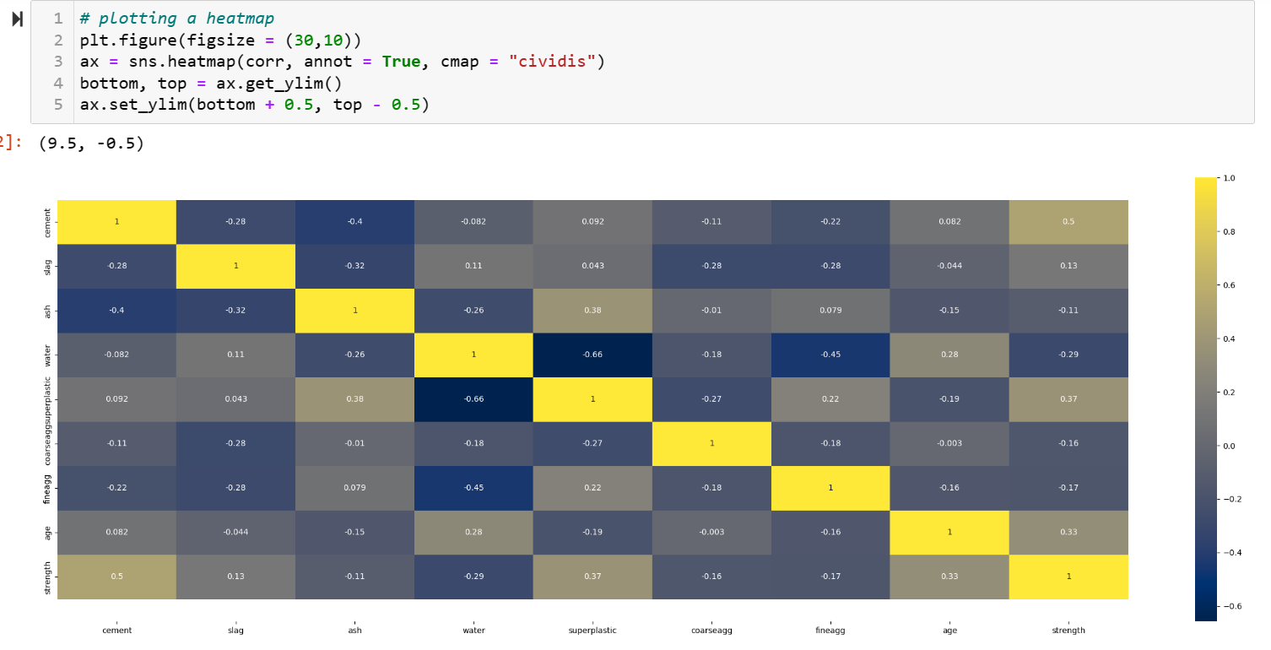
CORRELATION ANALYSIS: Heat Map
Observation:
From the above three plot it is clear that none of the independent variables have a strong relationship among themselves. So, there is no need to drop any of the features or to create a composite feature.
From the above plots (plots between strength and the predictor variables and the pairplot alongwith the heatmap) affirms the fact that none of the independent variables are good predictors of strength. Thus, there is no linear relationship between them.

Slide 9
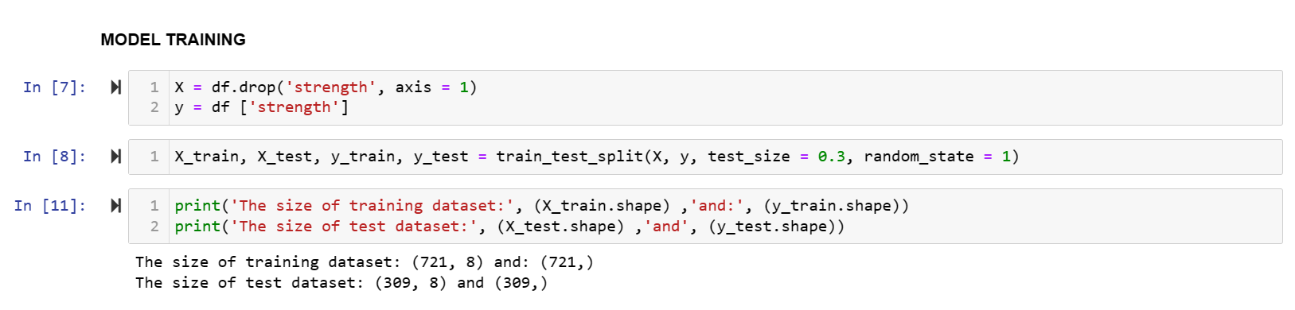
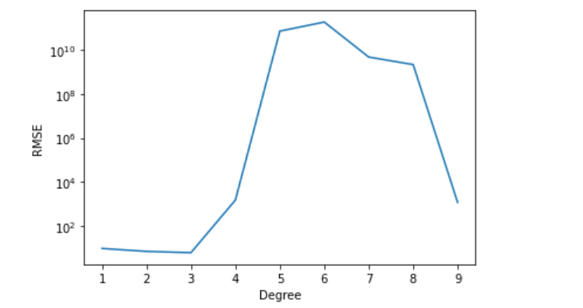
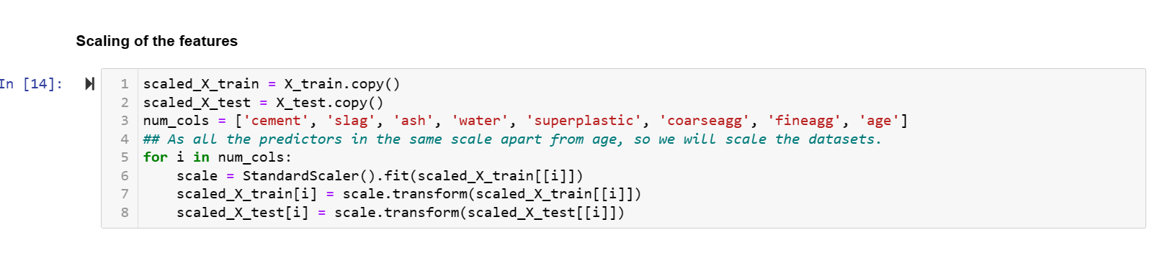
Scaling and Modelling of data…

Slide 10
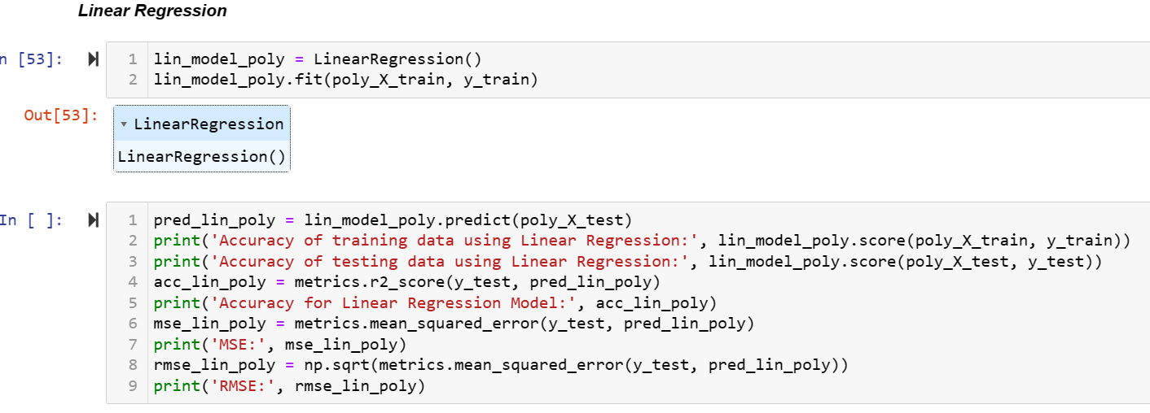
LINEAR REGRESSION
Observation:
The model is able to predict around 94% in training dataset and 87.5% in test data with an R2 score of 0.876 and RMSE of 6.01

Slide 11
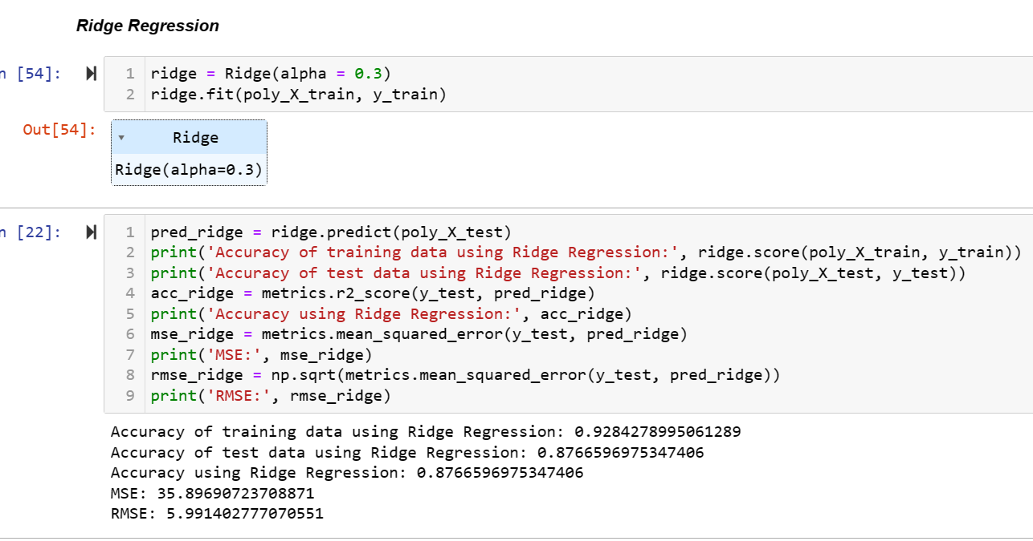
RIDGE REGRESSION
Ridge regression is the method used for the analysis of multicollinearity in multiple regression data. It is most suitable when a data set contains a higher number of predictor variables than the number of observations.
Observation:
The performance of the model based on Ridge (and polynomial features) is around 94% in training dataset and 88% in test data with an R2 score of 0.88 and RMSE of 5.89

Slide 12
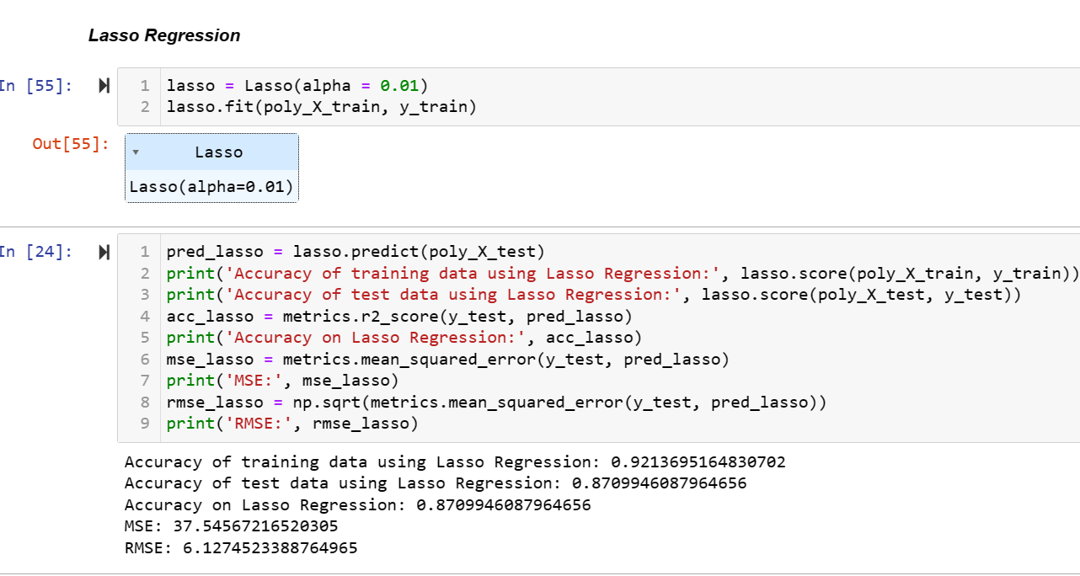
LASSO REGRESSION
The most 'classic’ use of LASSO is that you have a large set of variables, but only a small number of them are truly important.
Observation:
The performance of the model based on Lasso (and polynomial features) is around 93.29% on training dataset and 88.33% on test data with an R2 score of 0.88 and RMSE of 5.82

Slide 13
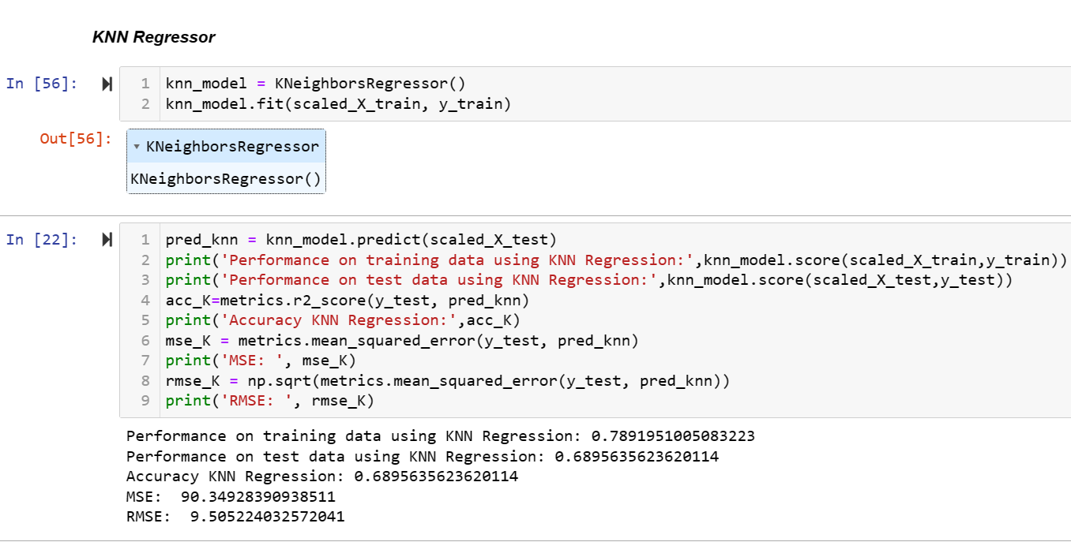
K-NEAREST NEIGHBOUR (KNN)
KNN models are easy to implement and handle non-linearities well. Fitting the model also tends to be quick: the computer doesn't have to calculate any particular parameters or values, after all.
Observation:
The model based on KNN Regressor (with scaled variables) performs poorly as it has an accuracy of just 85.5% on training dataset and 78.3% on test data with an R2 score of 0.78 and RMSE of 7.94

Slide 14
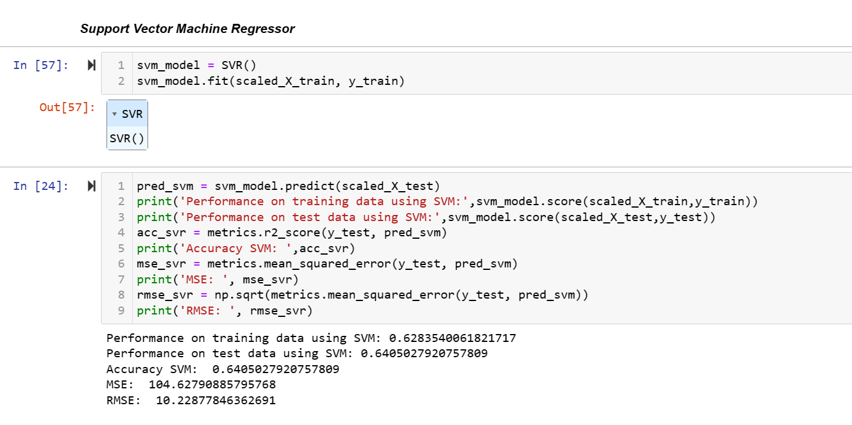
SUPPORT VECTOR MACHINE (SVM)
SVR can handle non-linear relationships between the input variables and the target variable by using a kernel function to map the data to a higher-dimensional space. This makes it a powerful tool for regression tasks where there may be complex relationships between the input variables and the target variable.
Observation:
The performance of the model based on SVR is quite poor as it just predicts only 71% on training dataset and 70% on test data (a fine case of Underfitting) with an R2 score of 0.70 and RMSE of 9.31

Slide 15
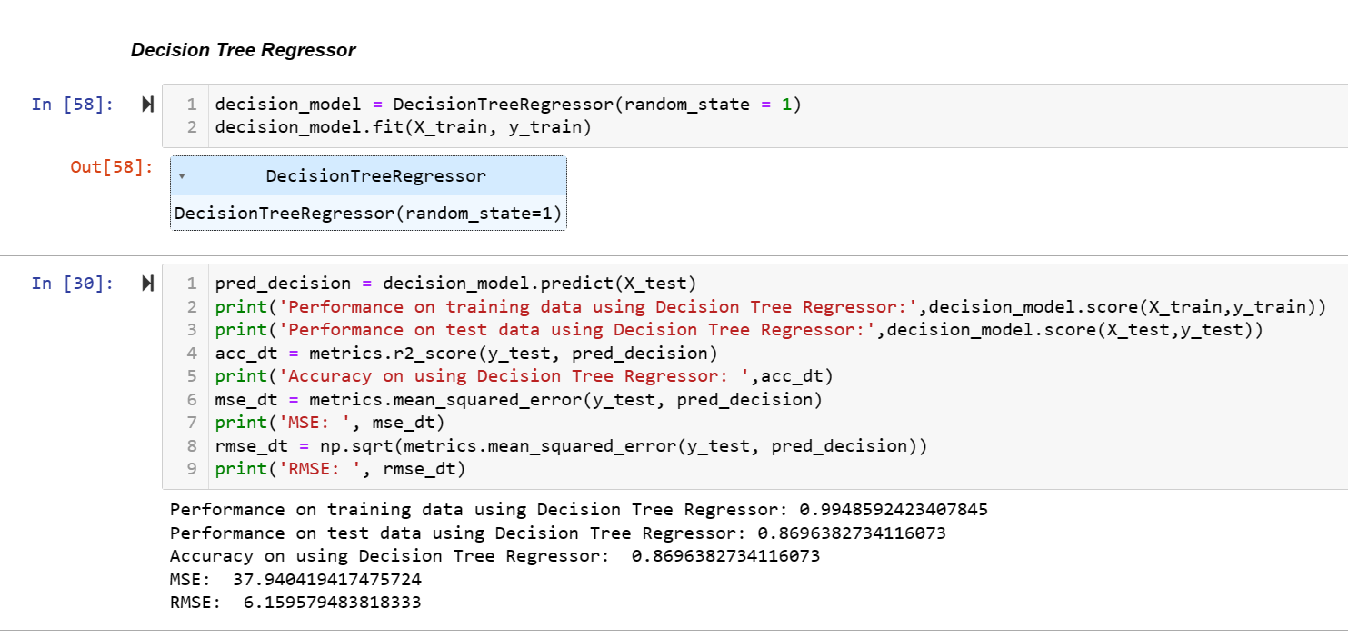
DECISION TREE
Decision tree regression observes features of an object and trains a model in the structure of a tree to predict data in the future to produce meaningful continuous output. Continuous output means that the output/result is not discrete, i.e., it is not represented just by a discrete, known set of numbers or values.
Observation:
The performance of the model based on Decision Tree Regressor is around 99% on training dataset and just 85% on test data (a fine example of Overfitting) with an R2 score of 0.85 and RMSE of 6.56

Slide 16
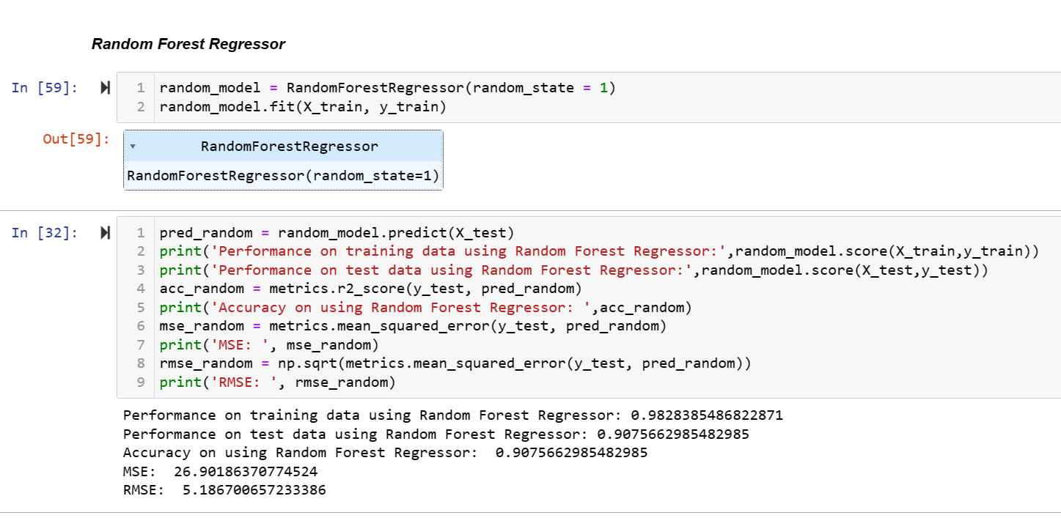
RANDOM FOREST
The basic idea behind this is to combine multiple decision trees in determining the final output rather than relying on individual decision trees.
Observation:
The performance of the model based on Random Forest Regressor is around 97% on training dataset and 90% on test data with an R2 score of 0.9 and RMSE of 5.32

Slide 17
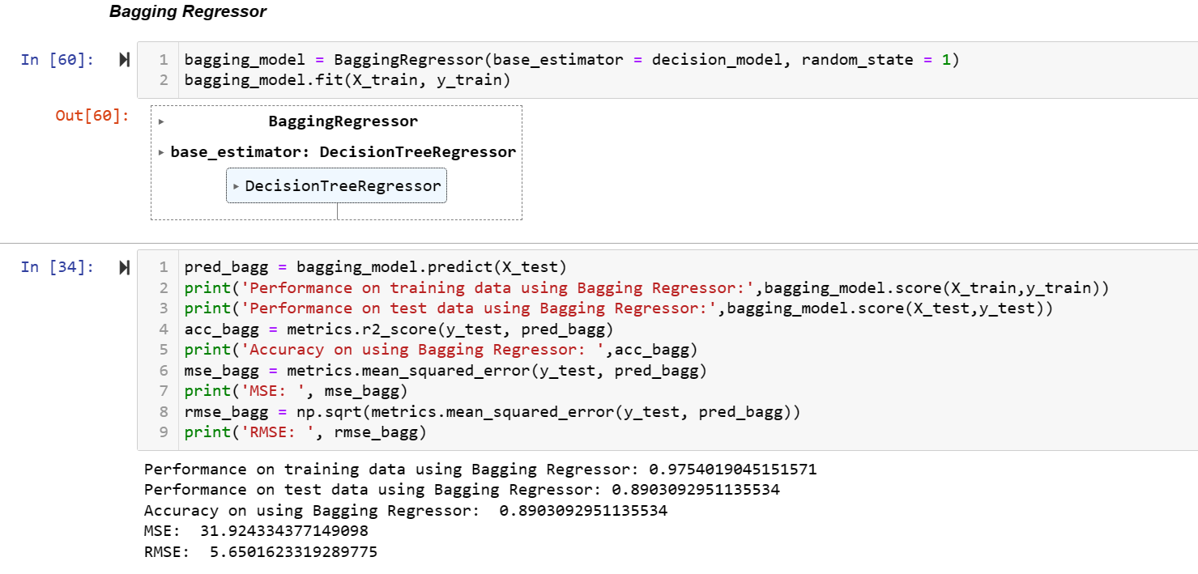
BAGGING
Bagging avoids overfitting of data and is used for both regression and classification models, specifically for decision tree algorithms.
Observation:
The model based on Bagging (and a Decision Tree based model as an estimator) performs 97% on training data and 89% on test data with a R2 score of 0.89 and RMSE of 5.74

Slide 18
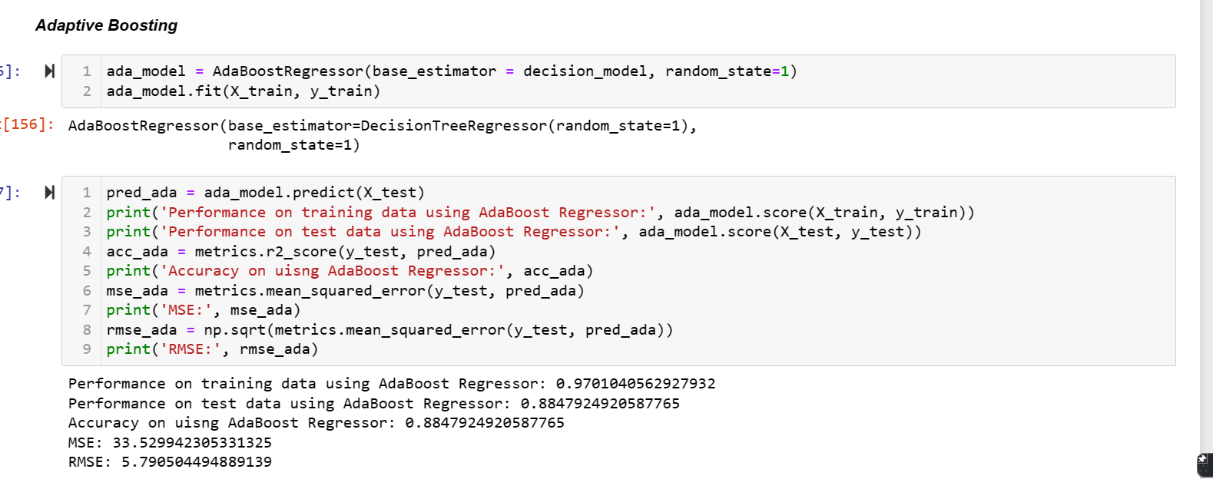
ADABOOST
Switching from linear regression to ensembles of decision stumps (aka AdaBoost) allows us to capture many of these non-linear relationships, which translates into better prediction accuracy on the problem of interest
Observation:
The model based on Adaptive Boosting Regressor (and Decision Tree Regressor as a base model) performs correctly 97% on training data while 88% on test data with a R2 score of 0.88 and RMSE of 5.79

Slide 19
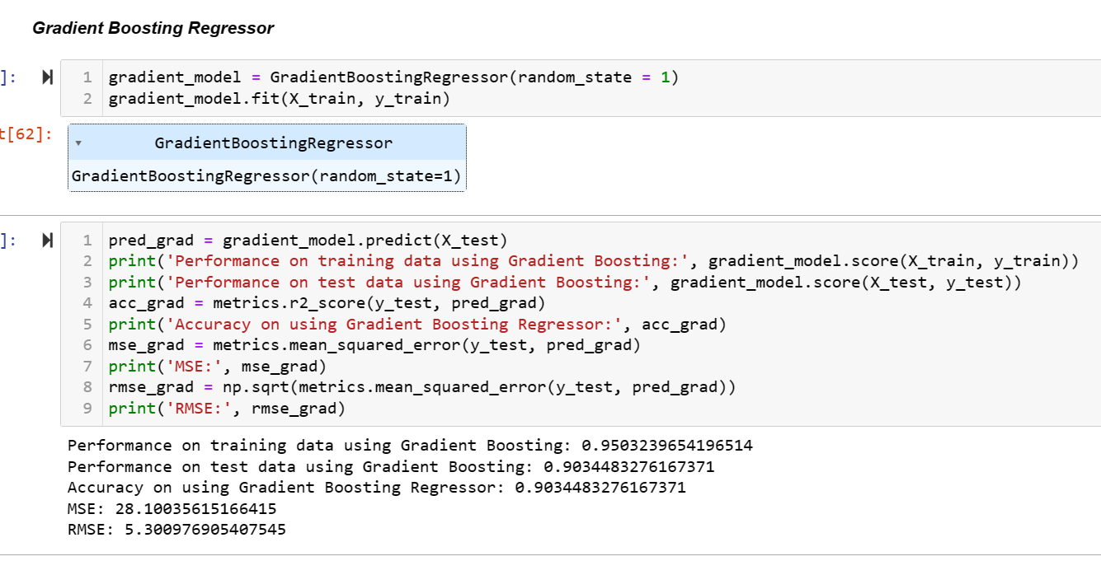
GRADIENT BOOSTING
Gradient boosting trees can be more accurate than random forests. Because we train them to correct each other's errors, they're capable of capturing complex patterns in the data.
Observation:
The model based on Gradient Boosting Regression performs accurately about 94% on training data and 89.2% on test data with a R2 score of 0.89 and RMSE of 5.59

Slide 20
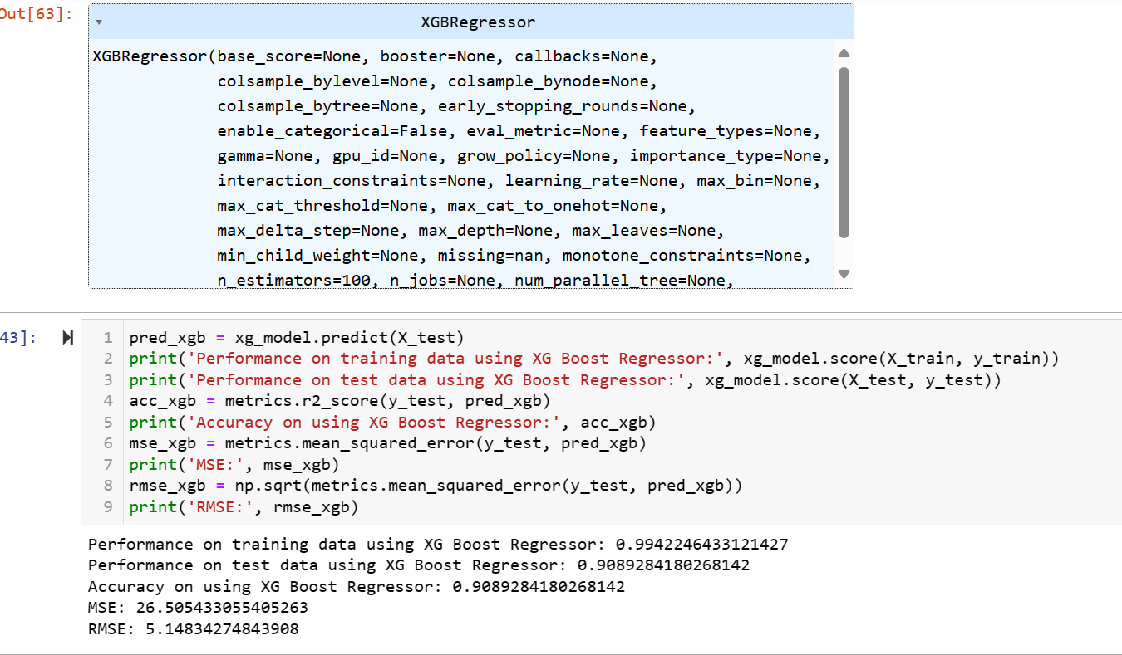
XG BOOSTING
XG Boost performs better than a normal gradient boosting algorithm and that is why it is much faster than that also. It also performs better when there is a presence of numerical and categorical features in the dataset.
Observation:
The model based on XG Boost Regressor performs accurately about 99.11% on training data and just 89.9% on test data with a R2 score of 0.899 and RMSE of 5.4

Slide 21
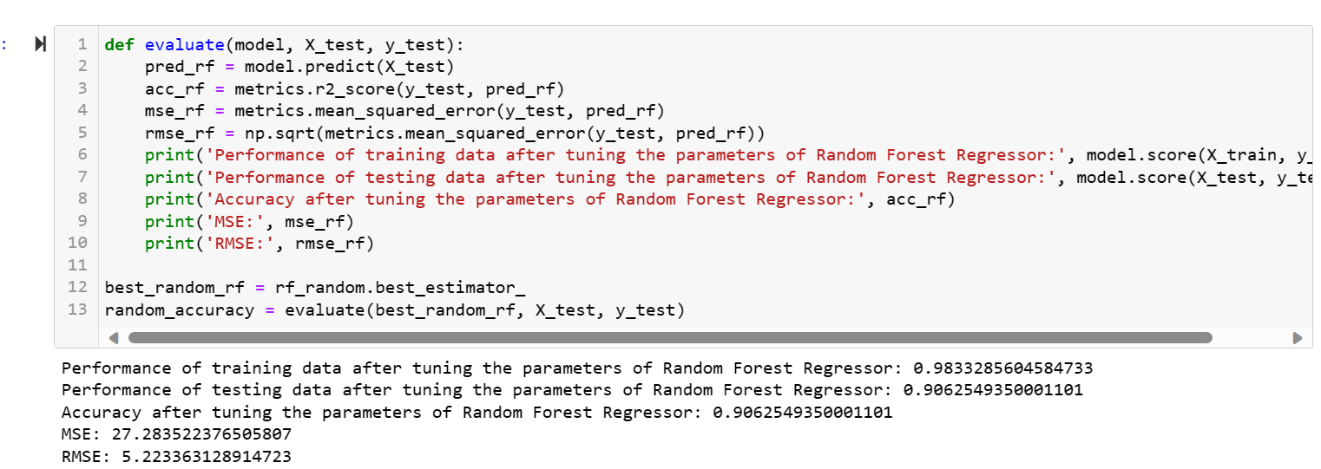
HYPER-PARAMETER TUNING (I)
Observation:
After training and predicting the model with Random Forest Regressor for their best parameter we were able to improve the performance of the model by a little bit. The model now correctly predicts 98% on training data and 90.367% on test data with an R2 score of 0.90366 and RMSE of 5.29

Slide 22
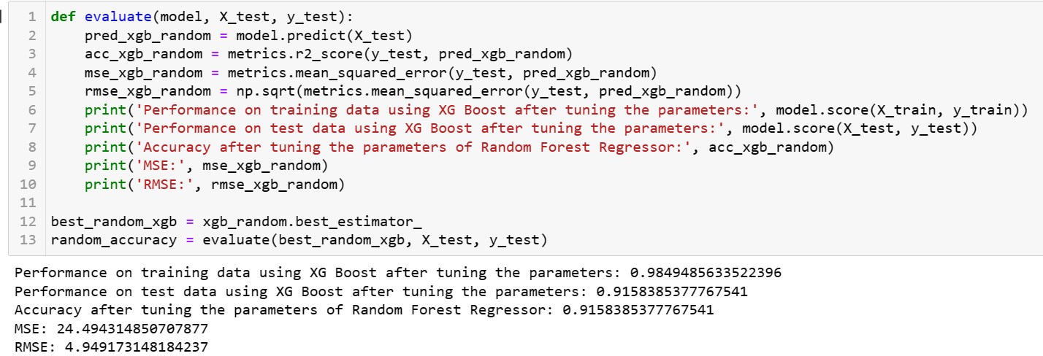
HYPER-PARAMETER TUNING (II)
Observation:
After training and predicting the model with XG Boost Regression for their best parameter we were able to improve the performance of the model. The model now correctly predicts 98.49% on training data and 91.58% on test data with an R2 score of 0.9158 and RMSE of 4.94

Slide 23
CONCLUSION
We can see that out of the twelve models tried out here the top three performers were (in descending order according to the R2 score obtained) : Random Forest Regressor, XG Boost Regressor and Gradient Boosting Regressor.
These three models also has the least RMSE when compared to the models developed by using other algorithms.
We need to use parameters based on polynomial features shows improvement when polynomial features were employed by Linear Regression
Tree based models have performed better as compared to other models. We must always tune our parameters of a model before stating that so and so model is the best performing one (as was observed in the case of XG Boost Regression).

Slide 24
DATA VISUALISTION: POWER BI: REVENUE & SALES ANALYSIS OF FOOD INDUSTRY
This dashboard was developed with an understanding of how small food joints, restaurants, and food stands that are major contributors to the food and beverage business compute their revenue and analysis.
Which aid in managing and analyzing the performance of their workforce and assist in understanding which product generates the most revenue and sales on an annual, quarterly, and monthly basis.
The dataset was obtained via LinkedIn Ideas on Power-Bi Dashboard Analysis projects. Data Source : Microsoft Excel (MS Excel) = A) Product B) Sales
Under ‘Sales’ data we have:
Order Date, Order No, Product Key, Sales-Person Key, Sales Person, Supervisors, Manager, Channel, Quantity and Unit Price
Under ‘Product’ we have:
ID, Product Name, Product Category
Three KPIs (Key Performance Indicators) are: Total Orders, Total Revenue and Average Prices

Slide 25
